Slide 1
Partnering to Develop Solutions to Affordable
Housing and Homelessness in Saskatoon

Slide 2
SHIP’s Strategic Plan
Vision
Mission
Saskatoon has affordable and appropriate housing options for all citizens
SHIP fosters collective action to develop creative housing and homelessness solutions
STRATEGIC PRIORITIES
Develop Appropriate and Affordable Housing Solutions
Manage Reaching Home Funding
Facilitate Saskatoon’s Homelessness Action Plan

Slide 3
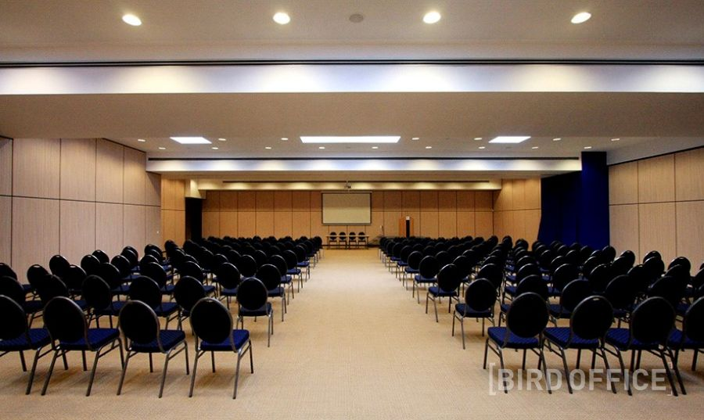
2019 in Numbers
140 Participants
$1.87 Million Invested
1368 Individuals Housed since 2015
1500 Attendees

Slide 4
Affordable Housing Development
The past year has had SHIP involved in projects to address the need for affordable housing in Saskatoon.
Sherbrooke Foundation Inc.
Feasibility and Demand Study
YWCA of Saskatoon
Feasibility Study
For a detailed list of 2019 Funded Projects Please refer to our Annual Report located on our website.
www.shipweb.ca

Slide 5
Developing Solutions to Homelessness and Affordable Housing in Saskatoon since 1999
2019 in Summary
Saskatoon agencies, shelters and housing providers continue to address the immediate needs of homeless people in Saskatoon
Supported housing programs are helping people stay housed
Community consultations expressed a need for a co-ordinated response to homelessness, SHIP continues to work towards the goal of a locally responsive system of coordinated access
Interagency collaboration is being encouraged to address gaps and reduce homelessness in Saskatoon

Slide 6
Saskatoon Homelessness Action Plan
2019 in Summary
A community response to homelessness is being guided by the community mapping document.
New community partners have joined the Extreme Weather Strategy.
SHIP experienced a transition in Executive leadership during 2019, while entering into a period which is now known as our current Covid Reality..
YET EVEN IN A COVID REALITY
SHIP’s inspiration remains: that homelessness in Saskatoon will be rare, brief and does not reoccur
Developing Solutions to Homelessness and Affordable Housing in Saskatoon since 1999

Slide 7
Saskatoon Homelessness Action Plan
2020 Sneak Peek
Signed agreement to manage Designated Communities and the Indigenous Homelessness Funding Streams to 2024.
Reaching Home 2020 investment
Designated Communities Fund - $755,568.00
Indigenous Homelessness Fund - $1,470,000.00
Reaching Home Covid Investment
Designated Communities Fund- $1,272,951.00
Indigenous Homelessness Fund- $2,798,812.00
Total 2020 Reaching Home Investment
$6,297,331.00
47 Projects reviewed and assessed by the Community Advisory Board
Point in Time Count postponed to March/April 2021
Expanded Extreme Weather Strategy, included new warm up locations
Community education and engagement through proposed webinar series.
Office relocation to Station 20 West.
Developing Solutions to Homelessness and Affordable Housing in Saskatoon since 1999

Slide 8
Saskatoon Homelessness Action Plan
2020 Sneak Peek
Hired new staff positions
Homelessness Action Plan Manager
Community Engagement Manager HIFIS
Communications Manager
Project Outcome Analyst
Reaching Home Financial Analyst
In house Bookkeeper
Covid Funded Housing Case Managers (3)
Point in Time Coordinator
Administration/Contract Assistant
Affordable Housing Project Advisor
Covid Response Projects
Temporary Youth Shelter
Transitional Housing release from Corrections
Expanded warm up locations including weekend availability
Support for Covid related supports including staffing, ppe, extra cleaning, food hampers to various community agencies
Intensive Case Management supports and outreach.
Renovations to meet covid protocols
Developing Solutions to Homelessness and Affordable Housing in Saskatoon since 1999

Slide 9
2020 Sneak Peek
Knowledge Transfer
Zoom, Webinar and Pod Cast Sessions (Jan 2021)
Facilitation of Collective Action Teams (Spring 2021)
Increased media engagement, social media and website information sharing
Research
Housing inventory, waiting lists, city-wide data gathering, and homeless prevention
Other communities best practices and success stories
Strengthening Programs
Facilitate access to training
Investing in new and existing programs
HIFIS Implementation shelter system
More Affordable Housing
Providing support and information to three private developers
Providing support and information to four not for profit housing/shelter organizations.
Developing Solutions to Homelessness and Affordable Housing in Saskatoon since 1999

Slide 10
Thank you for your time and consideration.
Developing Solutions to Homelessness and Affordable Housing in Saskatoon since 1999
Lyn Brown
Executive Director, SHIP

